Slide 1


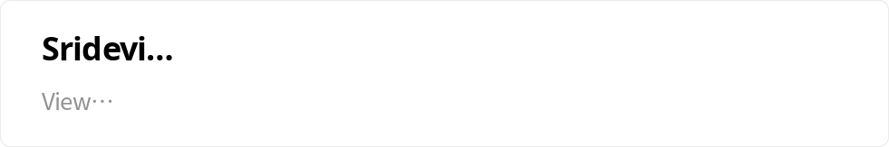

Study-Sphere
An E-Examination Platform
Welcome to Study Sphere, the cutting-edge online examination platform designed to meet the needs of students, administrators, and educators. With a user-friendly interface and powerful features, Study Sphere ensures a seamless and efficient exam-taking experience for all users.

Slide 2
Sridevi Manyam
21025A0570

Slide 3

Table of Contents
1. Introduction
2. Implementation
3. Use Cases
An overview of the Study Sphere platform and its key features.
Insight into the practical application and usage of Study Sphere for administrators and students.
Exploring the real-life scenarios and applications of Study Sphere in educational institutions.
4. Output Images
5. Conclusion
A collection of output images showcasing the visually appealing and informative exam results generated by Study Sphere.
In conclusion, Study Sphere is a comprehensive solution that provides a convenient and secure way to conduct online examinations.

Slide 4



Introduction to Study Sphere
Comprehensive Reporting
Interactive Interface
Adaptive Testing
Robust reporting capabilities that provide detailed insights into students' performance, aiding educators in making data-driven decisions.
The platform boasts an interactive and intuitive user interface, enabling seamless navigation and efficient handling of exam-related operations.
Utilizes adaptive testing methods to tailor exam content to the individual student, ensuring a personalized and fair evaluation.

Slide 5

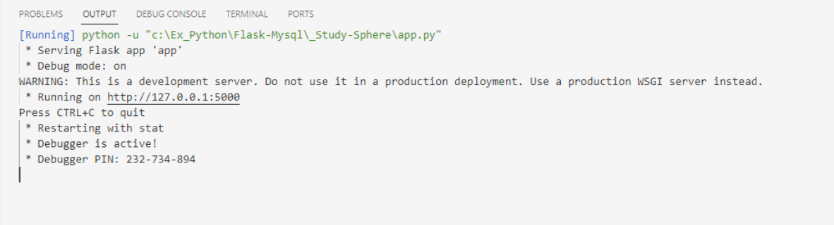
Implementation
1
Step 1 (Open)
Open the terminal and navigate to your project directory.
Step 2 (Execute)
2
Run the following python command
'''python app.py'''
3
Step 3 (View Results)
Visit the http://127.0.0.1/5000/ in your web browser.

Slide 6
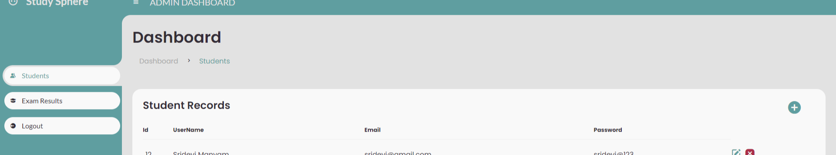



Admin Panel: Features Overview
Student Details
Results
Logout
Create and manage student logins along with viewing the existing student database.
Access comprehensive pass/fail details of every student to monitor and assess their performance.
Option to securely log out from the admin panel to ensure data privacy and security.

Slide 7
Student Login: Seamless Process
1
Read Rules & Regulations
Students go through the rules and regulations of the exam to ensure compliance and fairness.
2
Photo Capture
Students take their photo using a camera to validate their identity during the exam.
3
Check Device Compatibility
Ensuring the functionality of the microphone and camera for a smooth exam experience.
4
Answer Questions
Sequential appearance of multiple-choice questions to evaluate the students' knowledge.
5
Submit & View Results
After completion, students submit their answers and can immediately view their exam result.
6
Logout
Option to log out securely after completing the exam to maintain privacy.

Slide 8

Use Cases of Study Sphere
Remote Learning
Assessment Accuracy
Resource Optimization
Facilitates seamless remote learning and examination, ensuring students' academic progress is not hampered.
Ensures accurate and fair assessment of students' knowledge and performance, promoting educational excellence.
Optimizes resource allocation and reduces administrative burden through efficient exam management.

Slide 9

Proctor Monitoring
Integration of proctor monitoring tools to ensure exam integrity and prevent cheating during online exams.
Performance Analytics
Provides detailed performance analytics and reports to instructors for better understanding of students' strengths and weaknesses.
Customization Options
Offers customization options for instructors to create tailored exams according to specific learning objectives and assessment needs.

Slide 10

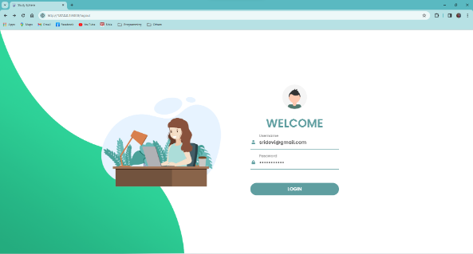
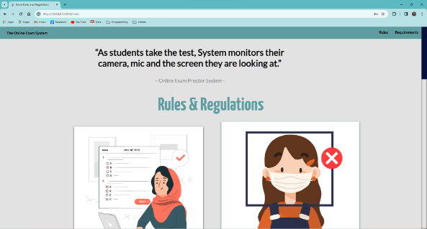
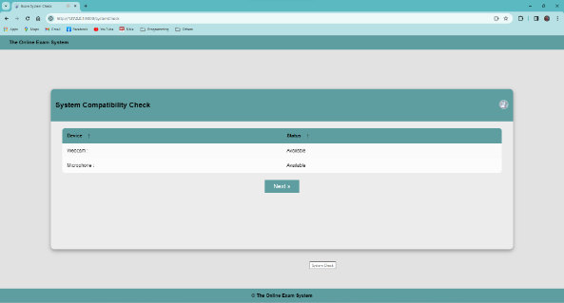
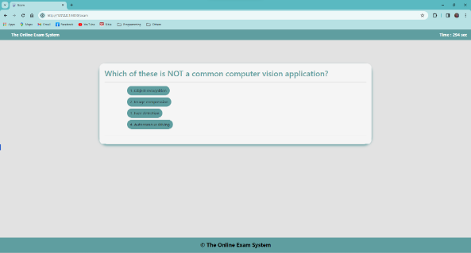
Output Images

Slide 11

Conclusion and Gratitude
1
Transformative Impact
2
Thank You
Study Sphere aims to revolutionize online examinations and set new standards in educational evaluation processes.
We extend our sincere thanks to all for their support and collaboration in shaping Study Sphere.

